Slide 1

IBM CHATBOT CHALLENGE
Final presentation
Group 7 – Agnes Lei, Kirsten Tallner, Quyen Duong, Jonas Klinkert, Martin Biber

Slide 2
USE CASE - PERSONA
01
FUNCTIONALITY/FEATURES
02
TABLE OF CONTENTS
ARCHITECTURE
03
SHOW TIME
04
REFLECTION & LESSONS LEARNED
05
Business case
Customer persona
Assistant profile
List of all functions
System architecture
Conversation design
Environment
Video for prototype
Only advanced features not in the midterm

Slide 3

USE CASE & USER PERSONA

Slide 4


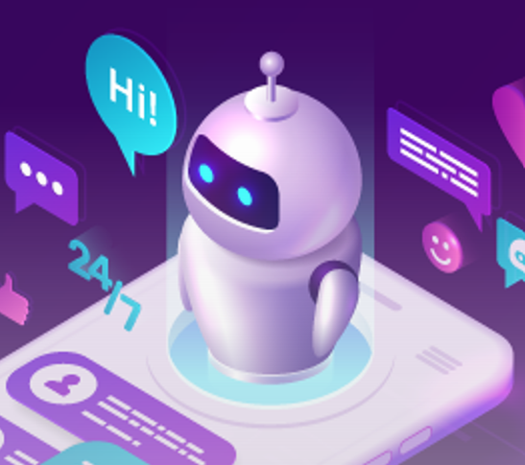
Smart Invest with Neo Bank "Yo"
Existing
Simple banking services
Accounts
Payments
Desire
Neo Bank Yo
Investment information solutions
Information on all assets via one interface
Latest news on trending assets
Conversation summary to clients‘ email
Order solutions
Buy & sell, advanced orders (stoploss, market, limit)
Chatbot
Invest money via a Neo-bank
News & info on assets
Immediate solutions
Save time
Customer
Company

Slide 5

Summary of user persona
Age
20-35
Preference for the chatbot
Roles
Various
Cool design
Education
Various
Young language & friendly tone
Language
English
Convenience, save time
Lifestyle
Busy, modern & urban
Ease of use
Knowledge on finance
Low to medium
Personality
Goals & Needs
Frustrations
Active
Young
Bold
Swag & trendy
Clear life goals
Solid wants & needs
Tech-savvy
Risk tolerance
Invest money
Info about financial news, assets
Especially interested in crypto currencies
Convenient, user-friendly, cool & young conversations with the chatbot
Problems solved
Save time
No time to gather news from different websites
Unreliable information
Hard-to-use interface
Complicated banking procedure
Problems are asked but not solve or take long time to solve
Old-fashion banking style

Slide 6
ASSISTANT PROFILE & FUNCTIONALITY

Slide 7

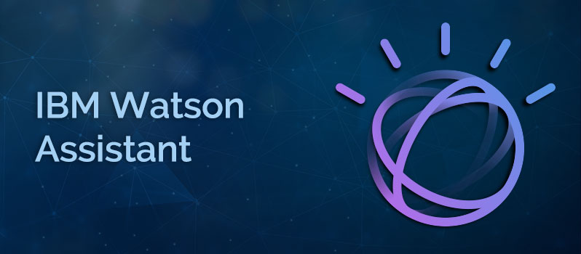
Yoyo
Bio
Basic & extended functions
25 years old in the virtual world
Female
Speaks English
Father: Watson Assistant
Personality
Cold
Friendly
Motivations
Conservative
Open-minded
Help users, answer their questions
Solve problems
Perform complex tasks
Give the most relevant information
Have a smooth conversation flow
Provide young vibes
Introvert
Extrovert
Passive
Active
“Welcome to Yo Bank chat. My name is Yoyo, a virtual assistant. How can I help you?”
Unsupportive
Supportive
Notes:
Handle critics with calm attitude

Slide 8
Greet
Provide info
Say hi & goodbye with clients’ name
Yo Bank, coins & stocks
Show trends
Order
top 10 most mentioned coins & stocks on reddit
Coins & stocks
FAQs
Display price charts
Using Watson Discovery
Coins & stocks
React to feedbacks
Conversation summary
Accordingly, to positive or negative messages
Send to email
Connect
Human agents

Slide 9
ARCHITECTURE

Slide 10



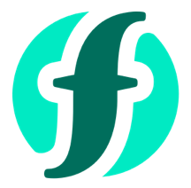




System Architecture
coingecko.com Crypto info
alphavantage.com Stocks & crypto info
Cloud Function
quickchart.io Dynamic charts
Dialog Skill
apewisdom.io Reddit trends
3rd Party APIs
Web
Chat
Search Skill
User
Nodemailer/outlook Conver. Summary (logs)
Watson Discovery
Yoyo Virtual Assistant
Send Email

Slide 11
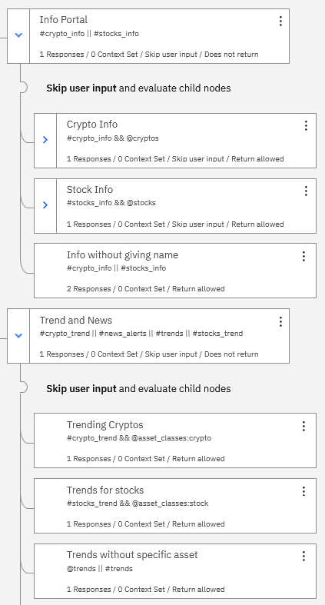
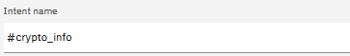
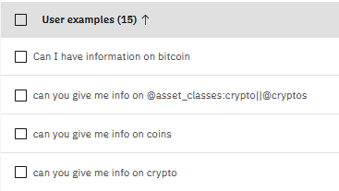
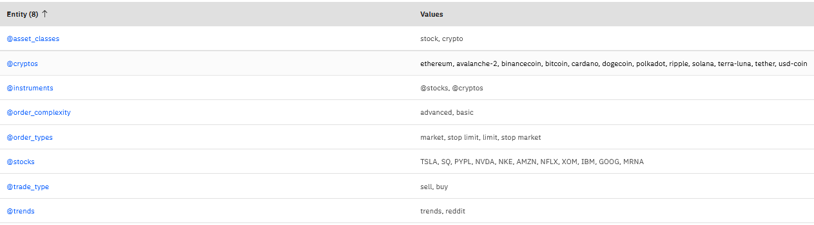
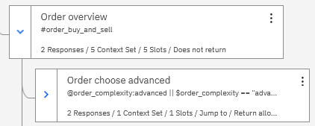
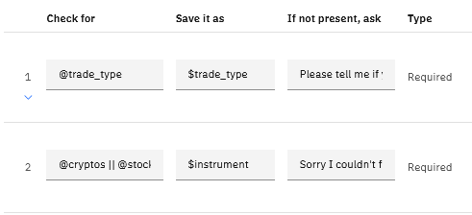
Conversation Design
Modular Dialog Design
Based on
#Intents
@Entities
Illustrative
Illustrative
Slots for complex user interactions
Illustrative
Notes:
How many nodes , how many intents we have till now

Slide 12

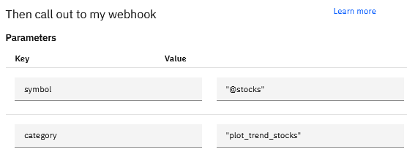
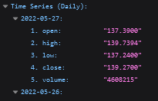
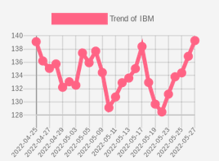
Price Chart – Stocks & Cryptos
0
1
2
Input
Get Price History
Get Chart
Dialog Skill
Symbol:
Stock (e.g. IBM)
Crypto (e.g. BTC)
Call alphavantage API https://www.alphavantage.co/query?function=TIME_SERIES_DAILY&symbol={x}apikey={x}
Extract dates & prices from response
Call quickchart.io API https://quickchart.io/chart?w=150&h=150&c={params}
Return image to watson assistant
Cloud Function

Slide 13
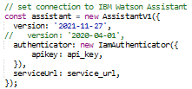
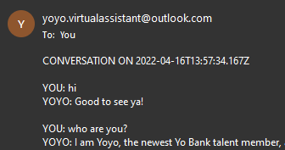
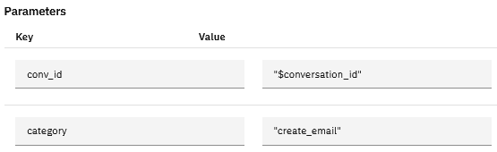
Email – Conversation Summary
0
1
2
Input
Get Conversation
Send Email
Dialog Skill
Conversation ID:
Context variable: $conversation_id
Retrieve all conversation logs (Watson Assistant API v1)
Extract conversation (with conversation ID)
Use Nodemailer (Extracted Conversation)
Send via outlook.com (SMTP protocol)
Cloud Function

Slide 14
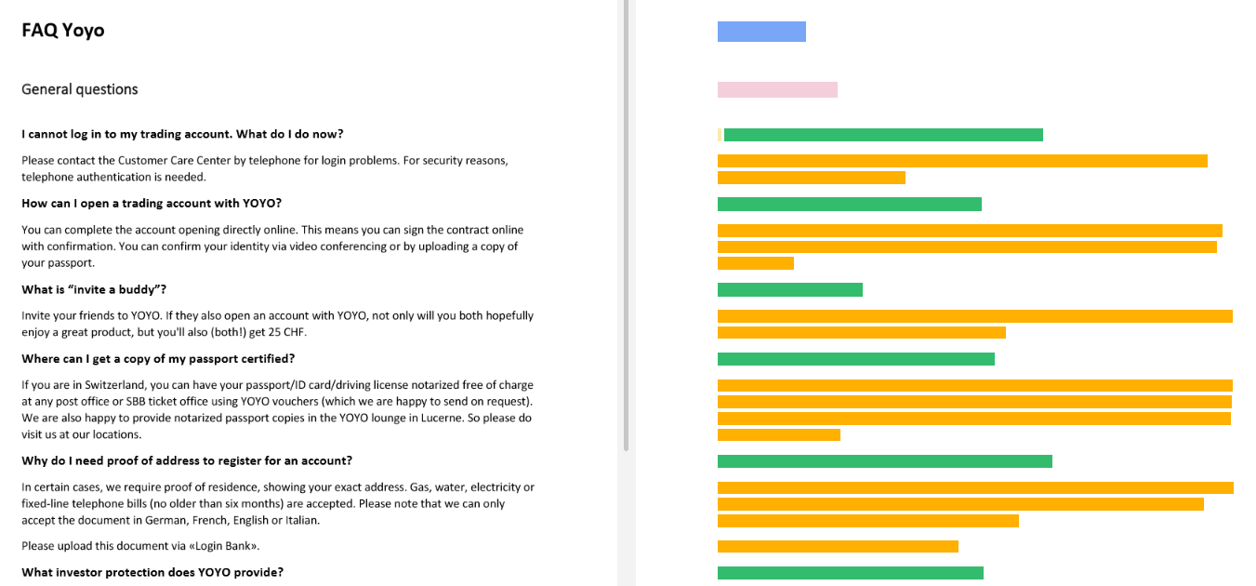

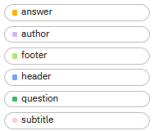
FAQs -Watson Discovery
Document
Fields
Search Skill
Watson
Discovery

Slide 15
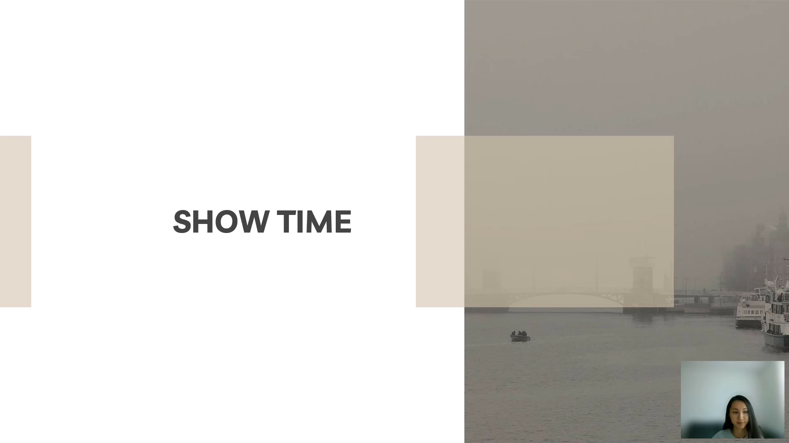
SHOW TIME

Slide 16
REFLECTIONS & LESSONS LEARNED

Slide 17
ORGANIZATION
DESIGN THINKING
AGILE APPROACH
REFLECTIONS
IBM CLOUD
WATSON ASSISTANT
IMPLEMENTATION & DELIVERY
Observe – Reflect – Make
Emphathy map
As is & To-be Scenario
User roadmap
User experience
Iterative
Work in small, consumable increments
Evaluate requirements, plans, results continuously
Change quickly
Productive
Various tools to communicate
Develop roadmaps, prioritize features, build product requirements
Use product analytics to make decisions
Work in various stages
Many services inthe resource list
Intents
Entities
Dialog design
Webhook
Search skill
Discovery
Back-end
Implement different basic & advance functions
Improve continously
Deliver MVP within time limitation

Slide 18
Effectiveness & effeciency Always share ideas & listen Open-minded
Communication
Help each other Teamwork makes dreamwork Flexible Everyone contributes their strengths
Collaboration
LESSONS LEARNED
Deal with uncertainty
Calm in unexpected situations Find optimal solutions Time management
Chatbot design
Real business case
Design chatbot fitting with use case
Logic of IBM chatbot

Slide 19

THANKS
Does anyone have any questions?
Follow the project updates
+41 76 888 66 66
group7.ch

Slide 20
APPENDIX FOR SLIDES FROM THE MID-TERM

Slide 21
Customer Persona 1
Description
Preference for the chatbot
Tyler is studying marketing at University of Zurich. Besides the study, he is also a part-time influencer, as Youtuber, TikToker and has an income from these sources. He recently opened a bank account with Yo and started making small investments. He does not have many investing experience, but he would like to have a cool and helpful financial services with good tips and advices.
Cool conversation
High-tech, modern language & presentation
Problems solved
Goals & needs
Reliable source of information
Invest saving money from the influencer job and see how it leads to Get up-to-date market information Learn more about the financial market Voice interface to be quick
Personality
Tech savvy
Trendy
Humble to learn
Curious
Love to invest
Risk-taking
Tyler Williams
Frustrations
Age: 23
Do not have find reliable insights
Overwhelmed with the amount of financial information available on the Internet
Do not have time to do financial analysis himself
Devices and channels
Occupation: BSc in Marketing, University of Zurich
Mobile apps
Websites
Social media
“I want some small investments with the money I earn from my side job.”

Slide 22
Customer Persona 2
Age: 31
Preference for the chatbot
Occupation: Dentist
Description
“I want to invest my savings into stocks and crypto currencies.”
Sophie lives in Geneva and works in a dental cabinet. She saves money from her income and would like to invest in some financial instruments, especially crypto currencies. She has some friends using Yo and they suggest her to start investing with Yo’s services.
User-friendly interface and friendly tone
Easy to use
Sophie Blanc
Goals & Needs
Easy to understand
Invest her savings
Access investments in a user-friendly app
Ask questions whenever she needs
Know more about different financial instruments
Buy/sell certain asset with chatbot
Save time
Personality
Frustrations
Emotional Stable, calm Discipline Reliable
She knows a bit about crypto currencies but not as much as her friends She would like to be informed and know more about crypto currencies Time constraint to dig into finance topic by herself Many banking applications are hard to use and not so convenient
Devices and channels
Mobile apps
Websites
Social media

Slide 23
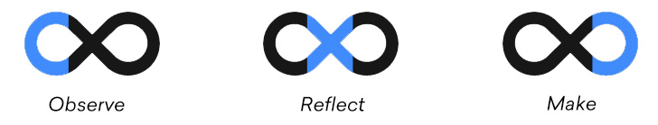
TIMELINE
DESIGN THINKING
BUILD BASIC BOT
BUILD EXTENDED BOT
DESIGN THINKING
Brainstorm.
Understand customers.
Emphathy map.
As is & To-be Scenario
Split tasks.
Basic dialog flow.
Provide information.
Reflect.
Observe.
Make.
Provide interaction with portfolio.
Send conversation summary per email.
START
MIDTERM
FINAL
The challenge begins.
Present chatbot with basic functionality.
Present chatbot with extended functionality.

Slide 24
INVESTMENT
BUY / SELL
FUTURE STEPS
PORTFOLIO
SUMMARY
STT
Provide information of possible investments
SEARCH SKILLS on FAQ from broker website
Buy / sell a certain amount of an asset
SLOTS
Clients can use voice interfaces to chat with the Yoyo
STT
PRICE
Provide information about portfolio performance
WEBHOOK ACTION
Send conversation summary via email
WEBHOOK ACTION
Price
Graphs

Slide 25



STAGE 1
PROJECT STAGES
STAGE 2
STAGE 3
DESIGN THINKING
Who is this bot for?
What functionality does it need?
How to set up the bot?
BOT WITH BASIC FUNCTIONALITY
Provide general info about a token.
Provide trend info from reddit.
BOT WITH EXTENDED FUNCTIONALITY
Provide description of possible investments.
Buy / sell a certain amount of an asset.
Provide info about user's portfolio performance.
Provide conversation as summary per email.

